Slide 1
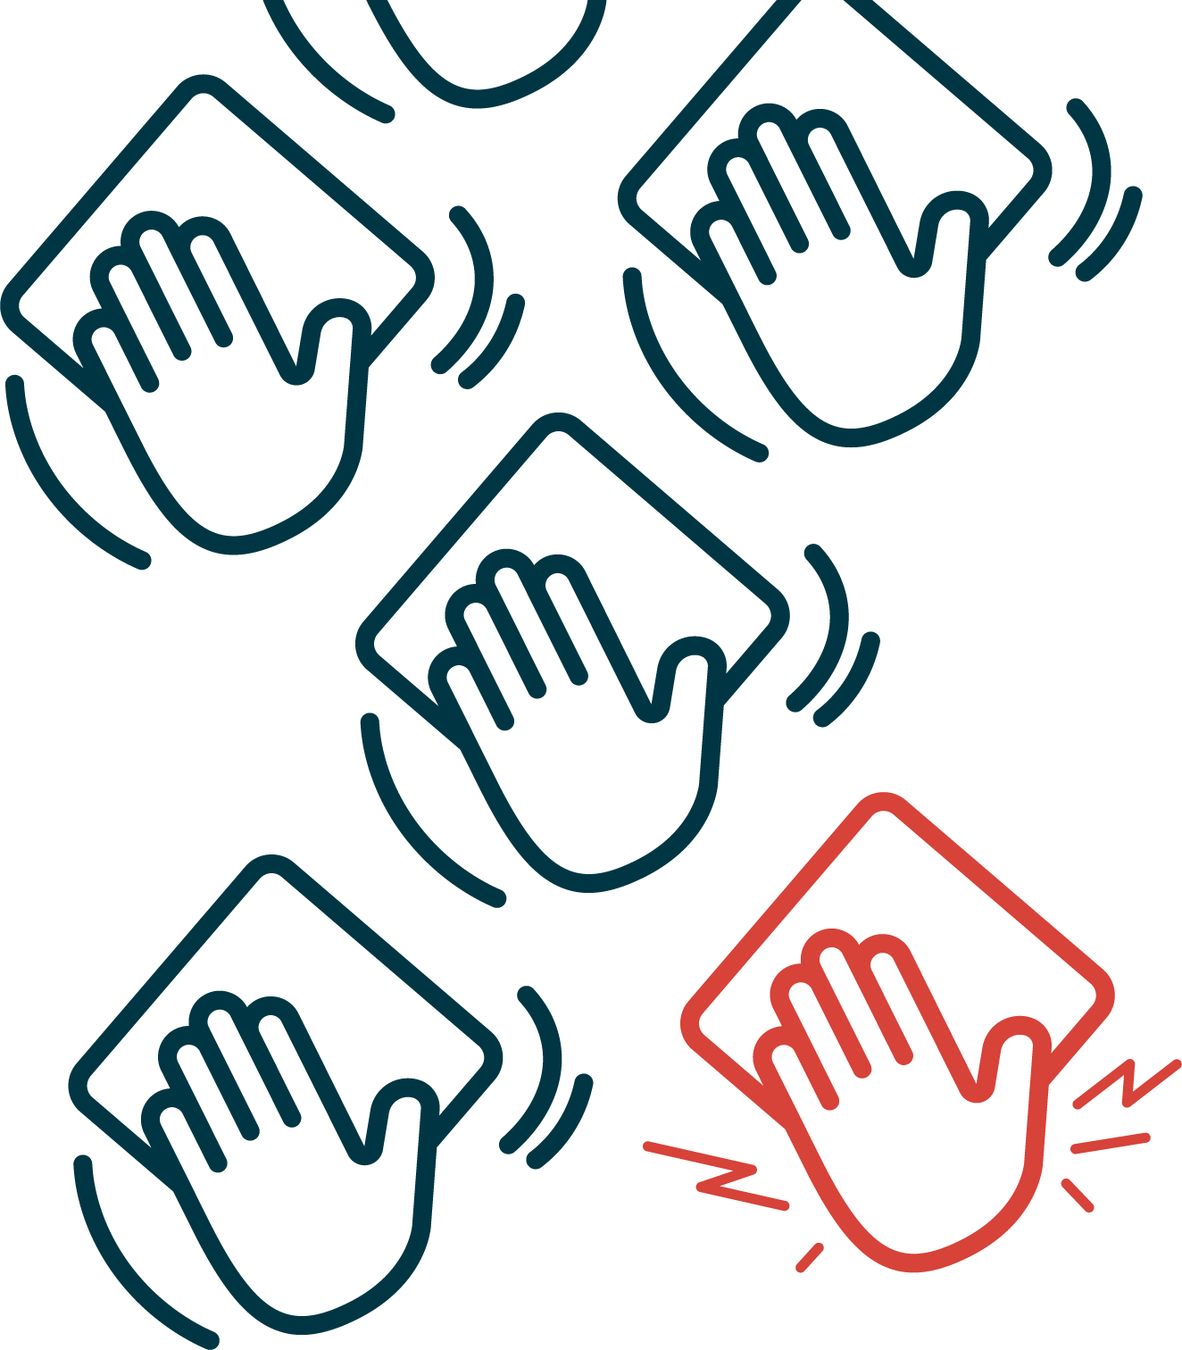
September 21–27
Notes:
[Employer can edit date to align with their own MWWW initiative]

Slide 2
What is an MSI?
Musculoskeletal injuries (MSIs) are:
Disorders of the muscles, tendons, ligaments, nerves, spinal discs and related soft tissues.
Include sprains, strains and inflammation conditions, which are commonly caused by working in awkward or sustained postures, performing repetitive motions or overexertion from lifting and handling activities.
Notes:
In other words, an MSI is when you get hurt from things like lifting too much, moving the wrong way or doing the same motion over and over.
They can happen suddenly or slowly over time.
In our workplace, common MSI risks are… [employer to speak to common risks in their workplace]

Slide 3
Is this a big issue?
Although MSIs may seem small, they are not.
MSIs can change your quality of life, impacting your physical and mental health.
MSIs happen far too often; about six workers in NL will sustain an MSI requiring time away from the workplace every day!

Slide 4
Are you at risk?
Aches and pain
Tenderness
Heaviness
Tightness
Numbness
Tingling
Burning
Swelling
Stiffness or loss of joint movement
Weakness or tired feeling in affected area
Report early warning signs to your supervisor
It is essential that, together, you identify and manage risk factors as soon as possible to avoid long-term injury.
Notes:
These are some common warning signs.
With some MSIs, signs and symptoms develop gradually and seem insignificant at first. Don’t ignore those warning signs. Take action before it becomes a serious injury.
[Employer can note supervisor(s) or reporting process for their workplace]

Slide 5
MSIs can be prevented
Let’s take action today!

Slide 6
THE GOOD NEWS
MSIs are preventable – by you!
Learning how to properly move your body can help you avoid injury and feel your best.
You can start by implementing good habits into your day-to-day work.
Before starting tough or physical work, warm up with movement exercises to prepare your muscles.
Reduce the weight and size of loads or use equipment when that’s not possible.
Notes:
[Employers are encouraged to add their worksite-specific tips to this list, or adjust the list to suit their workplace. You can find advice and tips for MSI prevention suitable for any workplace here: https://workplacenl.ca/employers/health-and-safety/musculoskeletal-injuries/]

Slide 7
THE GOOD NEWS
MSIs are preventable – by you!
Push rather than pull, even with smaller tasks like wiping down surfaces.
When lifting, keep your back straight and bend with your hips and knees.
Work with your elbows close to your body; avoid bending, twisting and reaching
Take short breaks for sitting; get up and stretch every 20-30 minutes.
Wear comfortable, supportive footwear.
Notes:
[Employers are encouraged to add their worksite-specific tips to this list, or adjust the list to suit their workplace. You can find advice and tips for MSI prevention suitable for any workplace here: https://workplacenl.ca/employers/health-and-safety/musculoskeletal-injuries/]

Slide 8
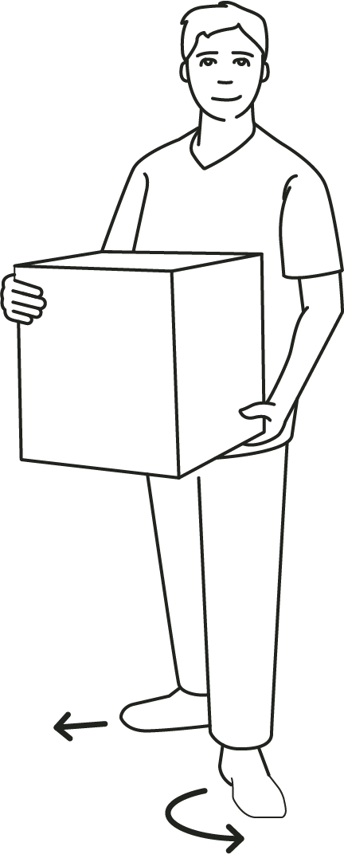
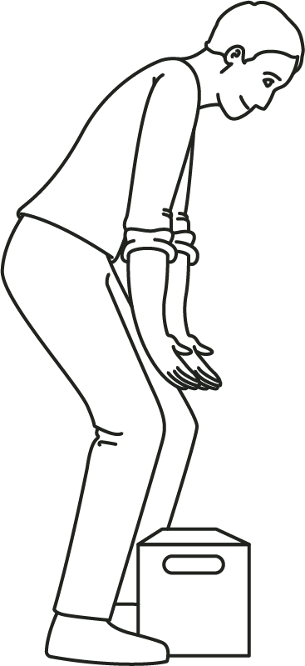
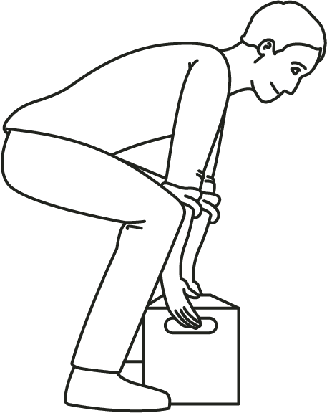
Avoid twisting your back. To change direction, keep nose between toes by pivoting your feet, pointing one foot in the desired direction and following with the other foot.
Back injuries caused by repetitive lifting and handling.
When lifting and moving objects:
Avoid bending your back. Bend your hips and knees instead. Hips should bend first. Think squat back.
Notes:
[Slides 8-12 provided as options. Employers can keep those which are helpful to their workplace, and delete any that are not. You can find many tips for MSI prevention, including videos, on the WorkplaceNL website: https://workplacenl.ca/employers/health-and-safety/musculoskeletal-injuries/]

Slide 9
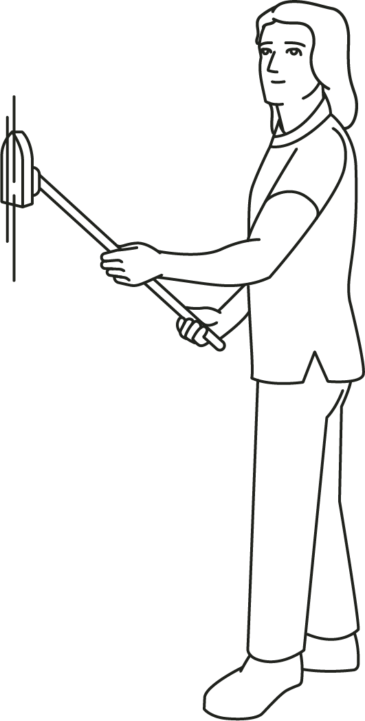
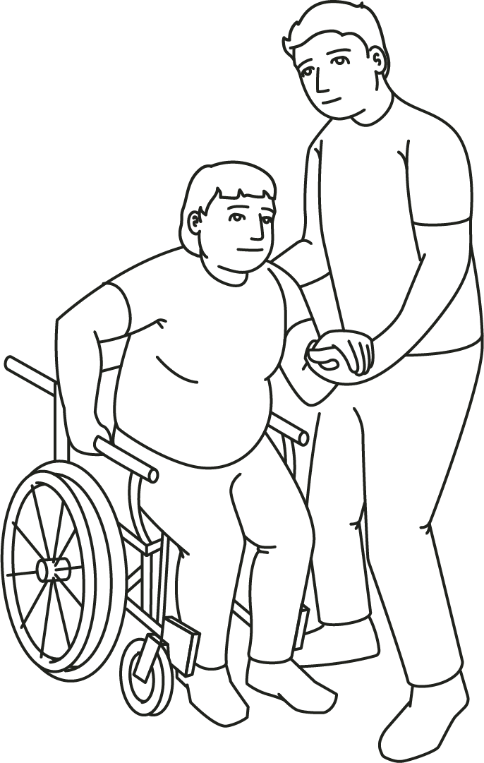
Use long-handled tools
for overhead, low-level
and far-from-the-body work.
Shoulder injuries caused by repeated reaching and working with arms away from body.
Avoid overreaching (working with elbows away from body).
Get closer to object or person.
Keep elbows close to your body.

Slide 10
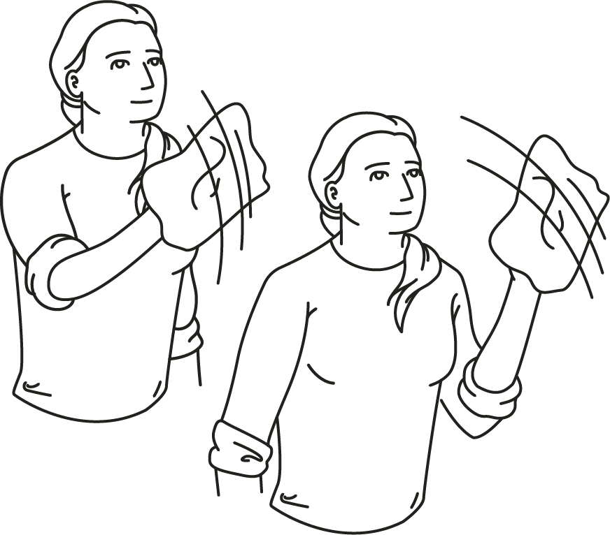
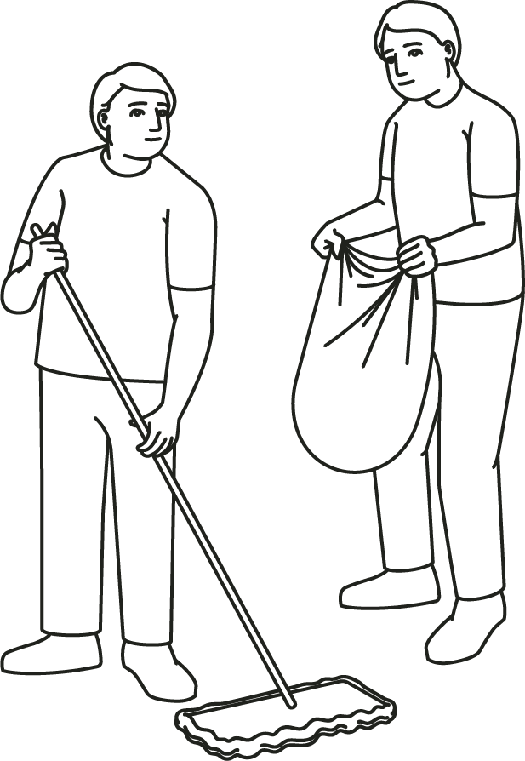
Wrist injuries caused by repeated bending, twisting and holding tools for extended periods.
Give your hands and wrists regular breaks to avoid a strain.
Avoid holding objects or tools for extended periods. Switch hands.
Frequently alternate between tasks so tired muscles can rest.

Slide 11
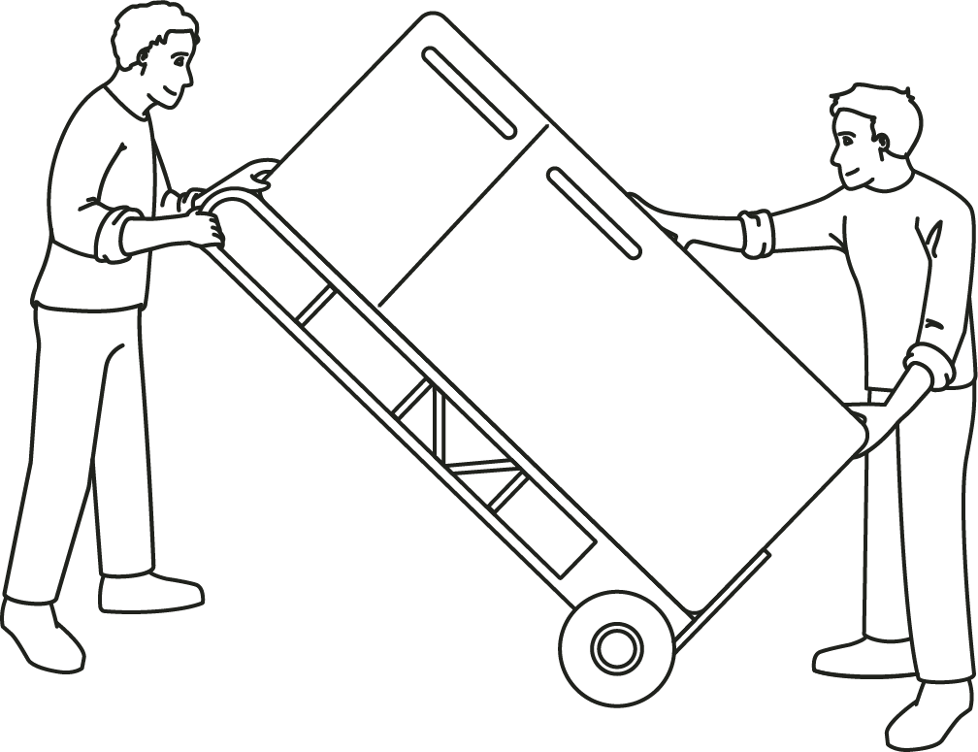
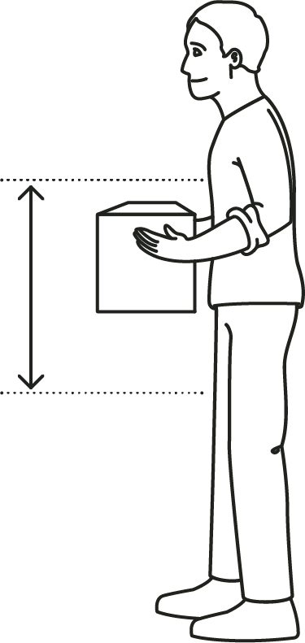
Can you reduce the weight
of the load? If not, use an assistive device, get help or both.
Back injuries caused by heavy lifting and handling.
Store heavier objects at or near waist height.

Slide 12
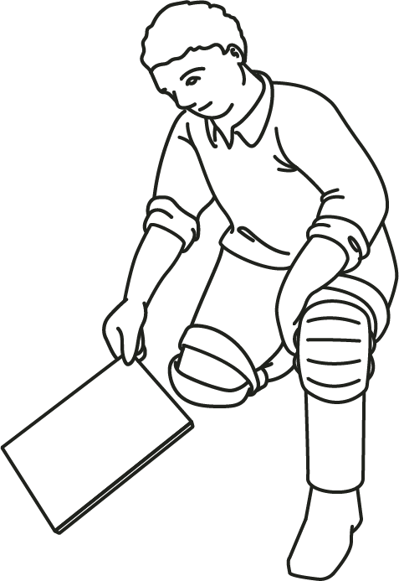
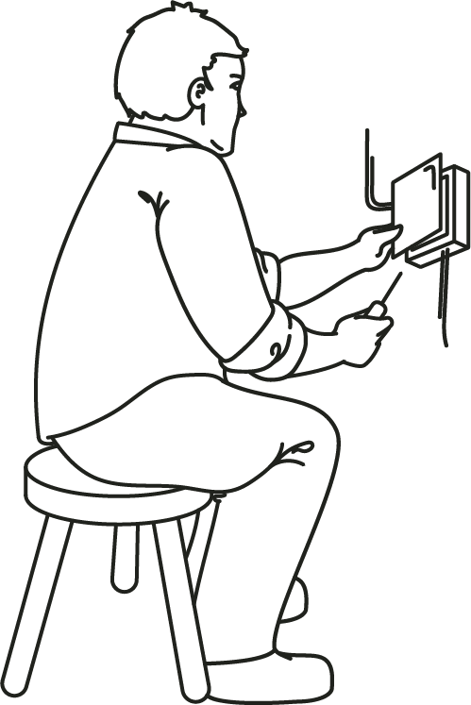
Knee injuries caused by repetitive work in kneeling position.
Use knee pads when kneeling cannot be avoided.
Sit on a low stool or seat when doing low level work to avoid kneeling.

Slide 13
Move Well Work Well Week 2025
Let’s come together to learn practical solutions for injury prevention during Move Well Work Well Week and all year round.
Where: | [ Meeting place ]
When: | [ Example: 10 am on September 21 ]
What: | [ Example: How to lift boxes and use ladders ]
Notes:
[Employer to add webinars, stretch breaks or other education for MWWW week here]

Slide 14
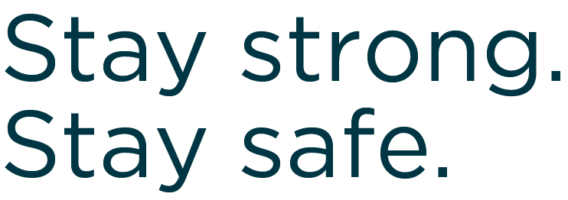
t 1.800.563.9000 e safety@workplacenl.ca
workplacenl.ca/mwww

